Slide 1

With Docassemble & Justice for all
HelpSelf’s mission to make
powerful document automation easy for anyone
Notes:
Dorna – CEO of HelpSelf Legal, which was started by myself an attorney and my co-founder Michael an engineer.
Ever since we found out about Docassemble, we have been amazed by the possibilities for legal aid, especially in a time when legal aid funding is low (as always) but access to technology is at an all-time high.
% of ppl who have cell phones, smart phones
At HelpSelf, our mission has been to make automated legal workflows accessible, to provide free services to the public, but also to allow for-profit lawyers to provide limited scope representation to their clients at really affordable rates. Help our non-technical clients create things people can use for the layperson and legal professional.
We admire and participate heavily in pro bono work in CA, but we also think there’s a need for low-bono services. And that needle won’t move without the assistance of technology and unbundled services.

Slide 2

We make Docassemble’s powerful system accessible to non-engineers
How we started & building from scratch
Why Docassemble?
HelpSelf’s document automation tool
Notes:
Story – how we got where we are now
How we started
Started with a platform for low/moderate income people to access legal services.
First tool was a DV platform that is still widely used throughout CA.
Outreach from other orgs across the country and in other countries asking about DV platform.
Expensive to build a system from scratch
Realized we could do more if we had software and worked directly with the organizations and stakeholders.
Tools out there
Looked at HotDocs, A2J Author, Tyler systems
Realized that Docassemble was the only one that gave us: power we needed, possibility to expand the platform, potential integrations with other platforms, and a clean and modern interface.
For our SRLs, it was also important to be able to paste photos/images/diagrams into the questions to guide them on their journey.
Now
Docassemble had what we wanted, but as a lawyer, it was really hard for me to help our clients build out tools.
So, we modified Docassemble to create a platform that looks a lot like Survey Monkey or Typeform (in how you create the questions), but easily integrates into Word and PDF forms that you want to automate. (Without any third party apps.)
It’s intended to be seamless and easy to use by non-engineers

Slide 3
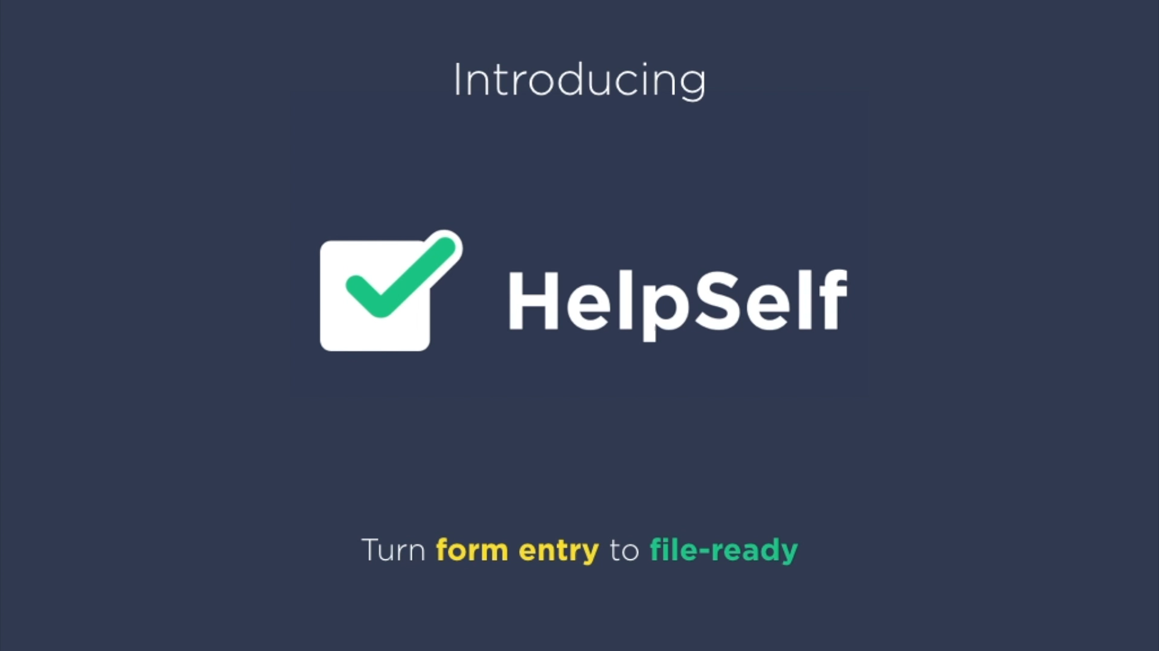
How does it work?
Notes:
I want to start by showing you our 1-minute demo video. This will give you an idea of what the platform looks like.
We don’t have the budget for a video team, so you’ll just hear me talking about the platform.

Slide 4
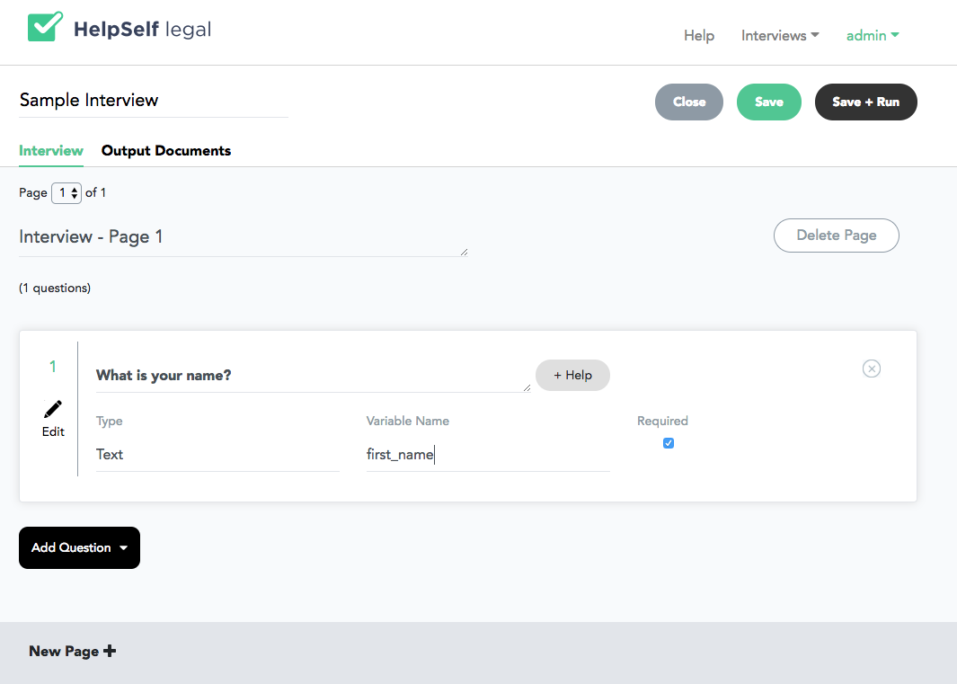
Interview Tab

Slide 5
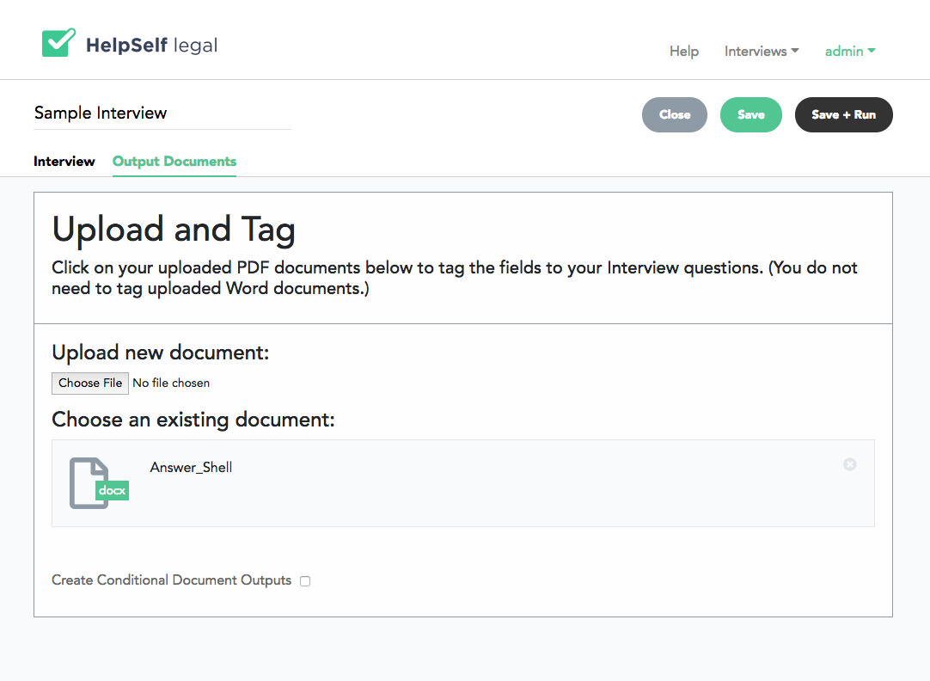
Output Documents Tab

Slide 6
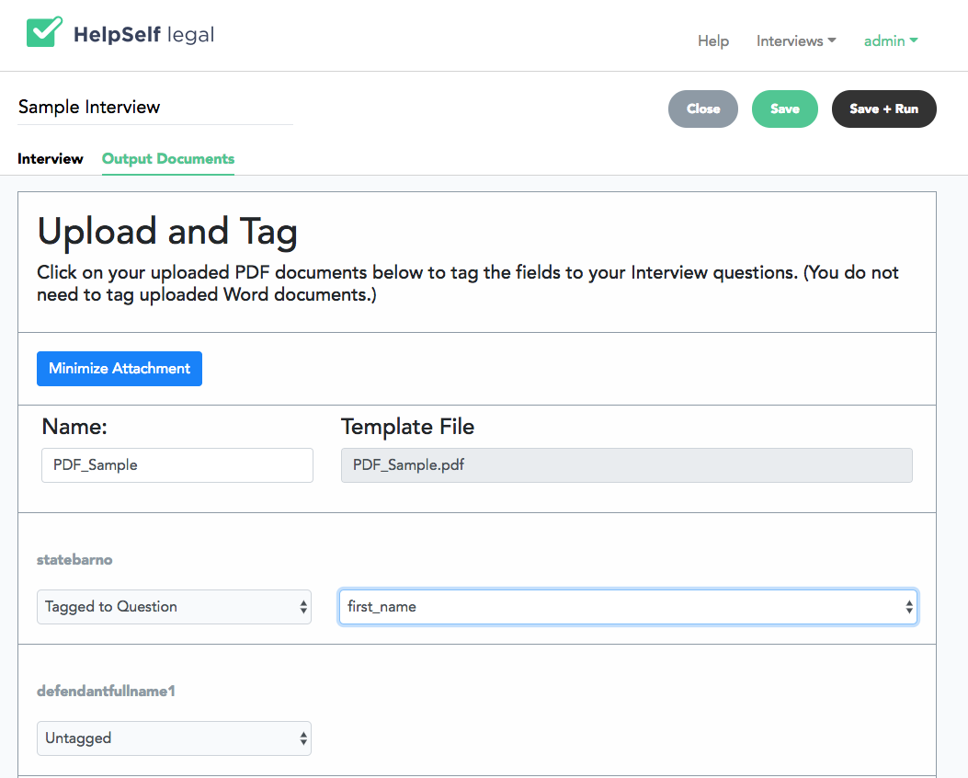
Output Documents Tab

Slide 7
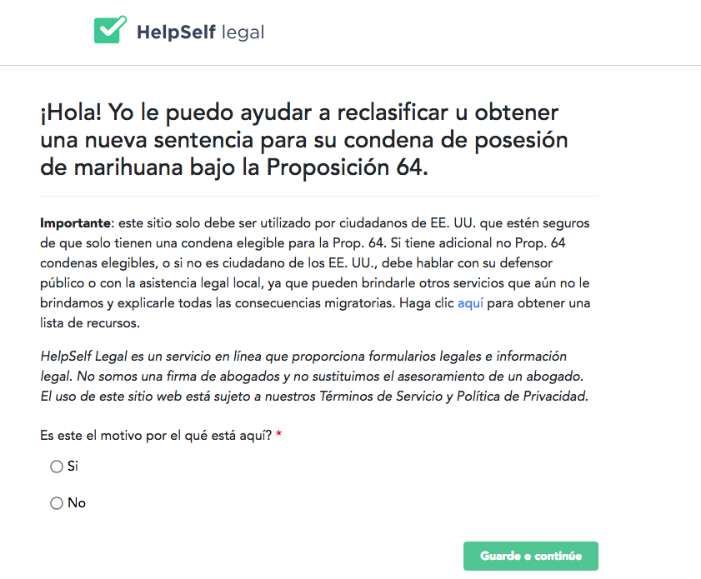
Case studies:
California Proposition 64 – resentencing and reclassification of marijuana convictions
Debt Collection Module
Attorneys
Public Defenders
Individuals
Notes:
Proposition 64 tool
Debt collection module – Coalition of Concerned Legal Professionals (multi-step module)
All tools in English and in Spanish

Slide 8
Legal aid and small firms are using our platform to build Docassemble interviews in all areas:
Intake
Family
Immigration
Discovery Responses
HR Documents
Full-Scope Client-Facing Interviews
Initial Intake
Internal Attorney Workflow
Paralegal Support
Assistance Learning Docassemble
Notes:
Family law is #1 area – Divorce, QDROs
Immigration forms – example of attorney who uses it for limited scope representation

Slide 9
Lessons we’ve learned from user testing a variety of platforms:
Legal design
Reader level functions built into Docassemble
Intro text length = be a barrier to starting interview
Images = increased comprehension
Positive affirmations and congratulatory text = increased completion
Notes:
Because our software is developing every day, we very often have
Info design (explanations, visualizations); product design (tasks); Service design (better experience); organization design (function better to support lawyers); System design (fn better to serve people, provide higher value, e.g., creating new court/agency/university program)
Legal design (as opposed to other design making someone consume or feel a particular emotion) is centrally about increasing a person’s capacity to make strategic decisions for herself
Making legal system navigable
Make people in legal system feel supported
Encourage legal health
Create data-driven smart tools to help people make wiser decisions
Coordinate legal services for a seamless user journey
Intro text – keep it short. The more specialists are looking at your workflows, the more disclaimer language will be added. Either keep it on the first page, or try to eliminate it by including shorter, simpler phrases re attorney client privilege (e.g.)

Slide 10

HelpSelf’s trajectory. What does the Docassemble community want?
PDF Unlocker and Field Renamer
Word Add-On for formatting
Practice management system integration
Docassemble coder interface
Analytics
Notes:
Want to hear from you what are the features you’re looking for.

Slide 11
Testing and Technical Questions
Want to be a user tester?
Have ideas for features you’d want?
Contact us at Dorna@helpselflegal.com
Notes:
Fortunately for Michael and unfortunately for us, Michael is leaving for a vacation today so he wasn’t able to join us, but if you have any technical questions that I can’t answer, we can always answer them after today.
re: the talk, without diving too much into the engineering, you could talk about how the customization that is needed to support users is coded into docassemble. That might inform the other DA users of helpful techniques they can use to improve their yaml/DA experience. Some things that come to mind:
- using `attachment code` to declare which attachments are sent to the user, and specifically the fact that the `attachment code` can be a reference to a variable or the actual `variable name`s of the documents themselves
- using a `code` block after a page with conditions to allow that page to be shown/hidden based upon input from previous questions (an example of this in the yaml is the block that begins with `#hslPageCondition`)
Data hygiene
Plug and play global CSS template like in CTFD

